Slide 1

Twin Health App: User Decision, Personas, and Research Improvements
By: Joshua Zimmerman-Gibson
Date: 1/5/2025

Slide 2
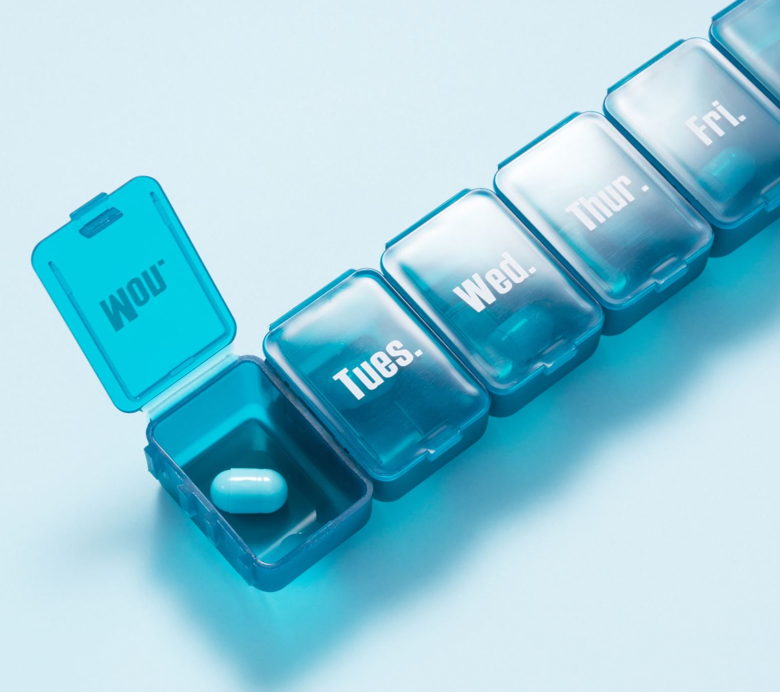
What is the Twin Health App?
It is an app that helps people with Type 2 diabetes, obesity, and hypertension.
It provides daily guidance, personalized nutrition plans, and continuous care team access.
It has integrated health data insights.

Slide 3
What made you decide to use the Twin Health app?
I was having issues with keeping my sugar and A1C down and needed some more targeted help.
It has the coaching and integrated health tracking and using the CGM’s and the wearables it helped to track all I was doing and not doing.
The logs and the food insight really helped me to know what was good for me and what foods my body did not respond well to.

Slide 4
What user personas did Twin Health likely focus on?
Likely Personas
The Chronically Ill Adult
Age 35–70
Managing Type 2 diabetes or obesity
Motivated by health improvement and physician oversight
The Data‑Driven Health Optimizer
Comfortable with wearables and health metrics
Wants detailed insights and progress tracking
The Coaching‑Oriented User
Prefers human support and accountability
Responds well to reminders and structured plans
The Low‑Tech or Hesitant User
Needs simple interfaces and clear instructions
May struggle with complex app navigation

Slide 5
What research interview questions should have been asked?
Questions to Improve Data Logging Burden
How much time are you willing to spend logging health data each day?
Which types of data feel most difficult or frustrating to track?
Would automated tracking through wearables reduce your burden?
Questions to Improve App Usability
Which parts of the app feel confusing or overwhelming?
How confident do you feel navigating health apps in general?
What features do you use most and least, and why?

Slide 6
References
Twin Health. (n.d.). Twin Health: Whole body digital twin for metabolic disease reversal. https://www.twinhealth.com
Rogers, Y., Sharp, H., & Preece, J. (2019). Interaction design: Beyond human–computer interaction (5th ed.). Wiley.
Marcilly, R., Peute, L., & Beuscart-Zéphir, M. C. (2016). From usability engineering to evidence‑based usability in health IT. Studies in Health Technology and Informatics, 222, 126–138.
Krick, T., Huter, K., Domhoff, D., Schmidt, A., Rothgang, H., & Wolf-Ostermann, K. (2019). Digital technology adoption in healthcare: A systematic review. BMC Health Services Research, 19(1), 1–14.

